Slide 1
“There is no waste in functioning natural ecosystems. All organisms, dead or alive, are potential sources of food for other organisms. A caterpillar eats a leaf; a robin eats the caterpillar; a hawk eats the robin. When the plant, caterpillar, robin, and hawk die, they are in turn consumed by decomposers.”
G. Tyler Miller, Author and Ecologist, 1971

Slide 2
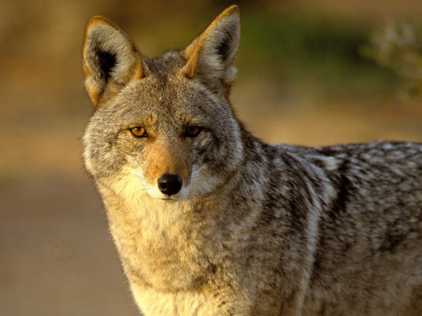
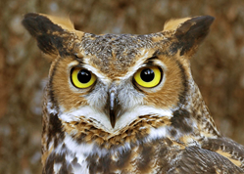
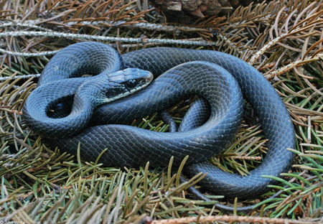
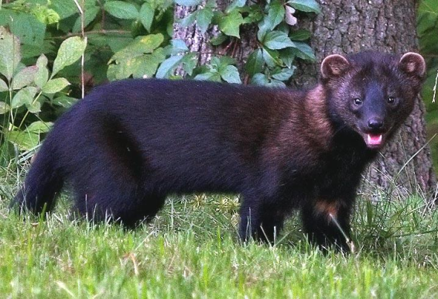
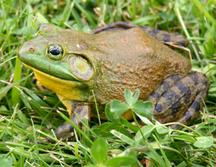
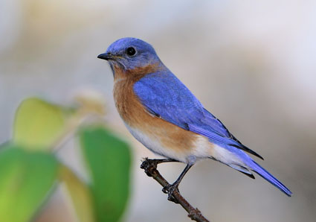
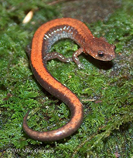
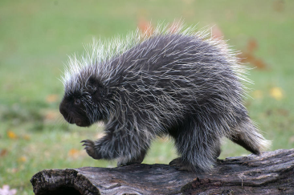
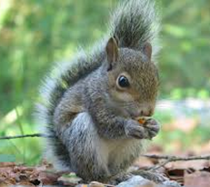
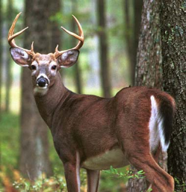
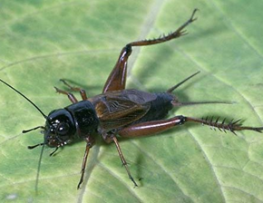
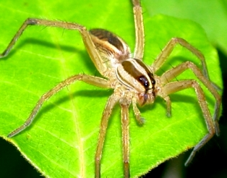
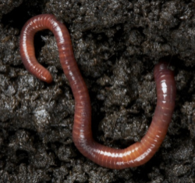
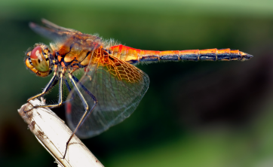
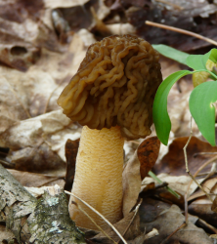
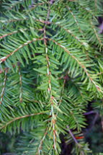
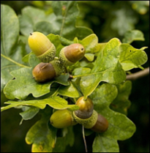
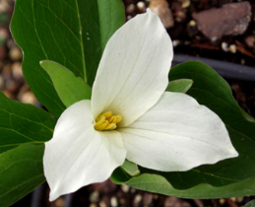
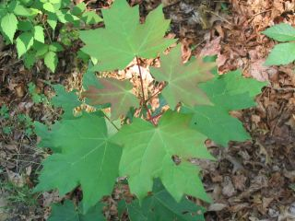
Detritivores
Notes:
Food webs show more a more comprehensive (but not necessarily complete) ways of representing species interactionsSpecies are linked to each other through multiple levels of interactions. Have students draw their own arrows to demonstrate who eats (and is eaten by) whom in this food web. If we imagine this as a single ecosystem, what happens when we remove a species? What are the apex predators? What are the primary producers? What are the secondary consumers? What are the omnivores? What are the carnivores? Herbivores? Autotrophs? Heterotrophs?

